Slide 1
ME 165
Basic Mechanical Engineering
Lecture 09
Kinetics of Particles
Sadia Tasnim
Lecturer
Department of Mechanical Engineering, BUET

Slide 2
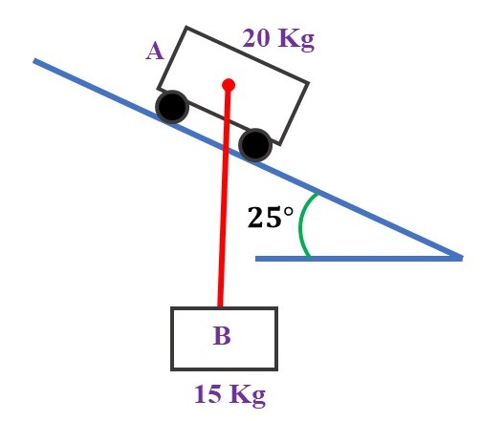
Equation of Motion
4
Problem:
A 15-kg block B is suspended from a 2.5 m cord attached to a 20-kg cart A. Neglecting friction, determine
(a) the acceleration of the cart,
(b) the tension in the cord, immediately after the system is released from rest in the position shown.

Slide 3
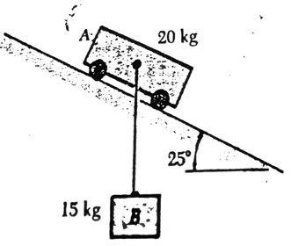
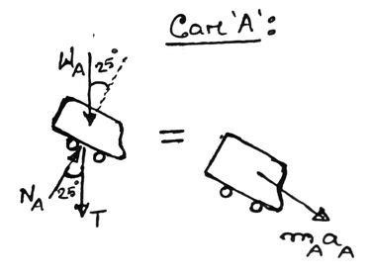
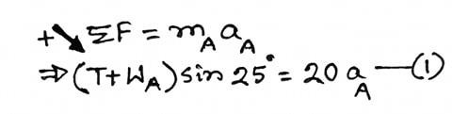
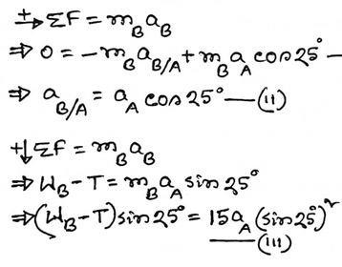
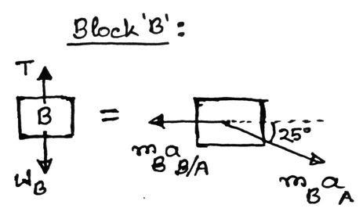
Equation of Motion
Solution:
5
Given,
𝑊_{𝐴} = 20 × 9.81 𝑁
𝑊_{𝐵} = 15 × 9.81 𝑁
𝑎 𝑎_{𝐴} =? 𝑏 𝑇 =?
Given,
𝑊_{𝐴} = 20 × 9.81 𝑁
𝑊_{𝐵} = 15 × 9.81 𝑁
𝑎 𝑎_{𝐴} =? 𝑏 𝑇 =?

Slide 4
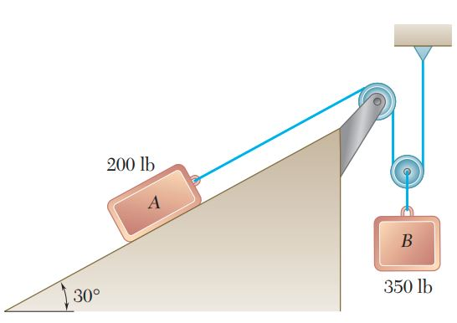
Equation of Motion
Practice Problem:
The two blocks shown are originally at rest. Neglecting the masses of the pulleys and the effect of friction in the pulleys and between block A and the incline, determine
(a) the acceleration of each block,
(b) the tension in the cable.

Slide 5
Curvilinear Motion: Tangential & Normal Components
z
y
x

Slide 6
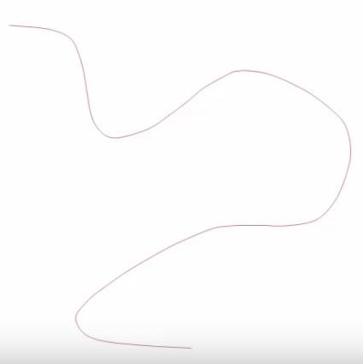

Particle Kinematics: Tangential & Normal Components
6
𝒗 = 𝑣𝒖_{𝑡}
ds
P
𝒂 = 𝑎_{𝑡}𝒖_{𝑡} + 𝑎_{𝑛}𝒖_{𝑛}
P’ 𝒖_{𝑡}
𝒂_{𝑡}
𝒖
𝑛
v
t
Here,
𝒂
𝑛
n
𝒂
𝑑𝑣
𝑎_{𝑡} = _{𝑑𝑡}
O’
_{𝑣}2
𝑎_{𝑛} = _{𝜌}
𝑎 = 𝑎² + 𝑎²
𝑡 𝑛

Slide 7
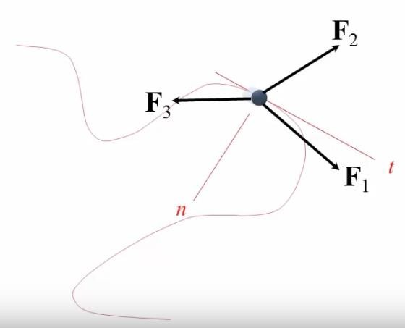
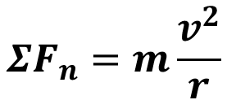

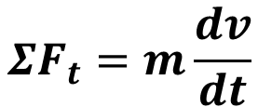
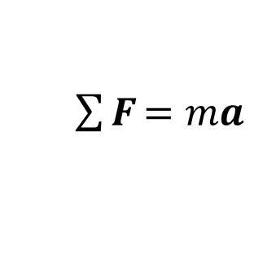
𝑬𝒒^{𝒏} of Motion: Tangential & Normal Components
$\sum{\text{F}}$ = 𝑚𝒂
$$ΣF_{t}=ma_{t}$$
$$ΣF_{n}=ma_{n}$$
$$ΣF_{t}=m\frac{dv}{dt}$$
𝒂_{𝑡}
𝒂_{𝑛}
$$ΣF_{n}=m\frac{v^{2}}{r}$$

Slide 8
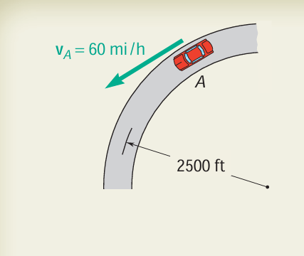
Kinematics
12
Problem:
A motorist is traveling on a curved section of highway of radius 2500 ft at the speed of 60 mi/h. The motorist suddenly applies the brakes, causing the automobile to slow down at a constant rate. Knowing that after 8 s the speed has been reduced to 45 mi/h,
determine the acceleration of the automobile immediately after the brakes have been applied.
Reference: Example 11.10

Slide 9
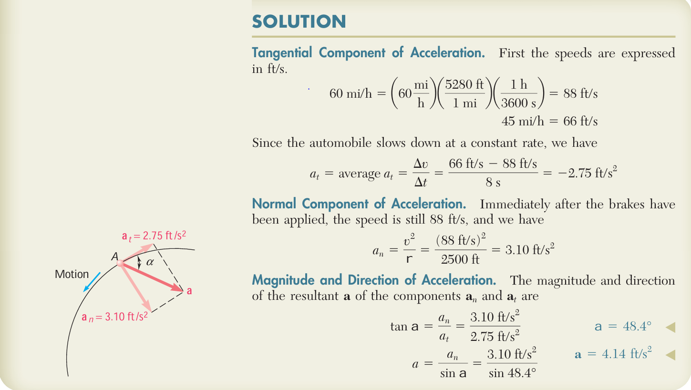
Kinematics

Slide 10
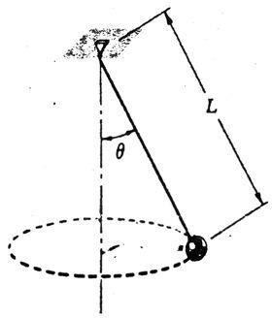
Equation of Motion
10
Problem:
A 2-kg ball revolves in a horizontal circle as shown at a constant speed of 1.5 ^{𝑚} .
𝑠
Knowing that 𝐿 = 600 𝑚𝑚, determine (a) the angle θ that the cord forms with the
vertical, (b) the tension in the cord.

Slide 11
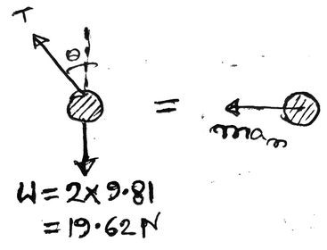
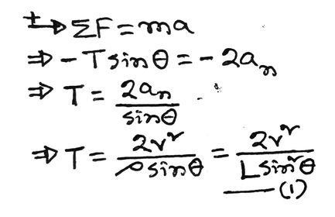
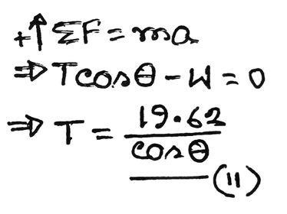
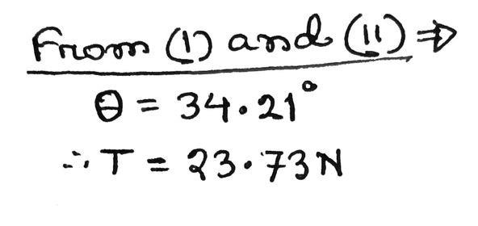
Equation of Motion
Solution:
11
𝜌 = 𝐿 sin 𝜃

Slide 12
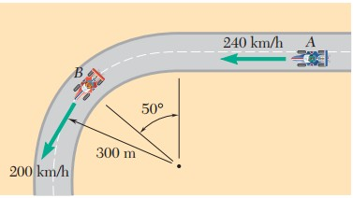
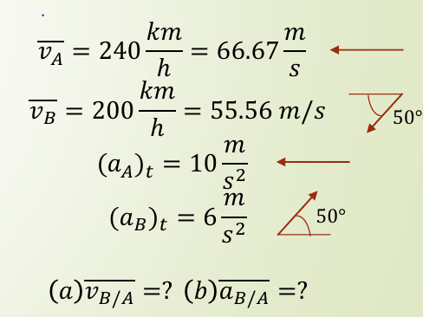
Particle Kinematics: Tangential & Normal Components
Practice Problem:
Race car A is traveling on a straight portion of the track while race car B is traveling on a circular portion of the track. At the instant shown, the speed of A is increasing at the rate of 10 𝑚/𝑠², and the speed of B is decreasing at the rate of 6𝑚/𝑠². For the position shown, determine
(a) the velocity of B relative to A,
(b) the acceleration of B relative to A.

